Slide 1

Cis 303 Capstone project
Musawir Mehfuz

Slide 2
Project outline
INTRODUCTION
SDLC
DESIGN ALGORITHM
OUTPUT
JIRA IMPLEMENTATION

Slide 3
Introduction
Good afternoon class Today I will be going over a project I worked before which was a TIC-TAC-TOE game and I made some updates with bootstrap and have added another game to it which is a number guessing game

Slide 4


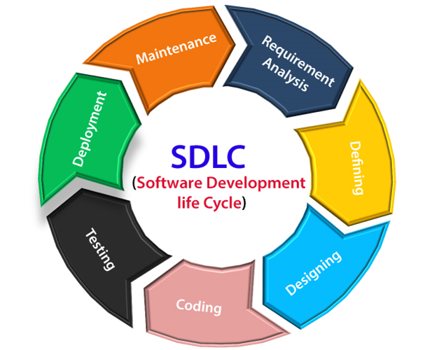

SDLC

Slide 5

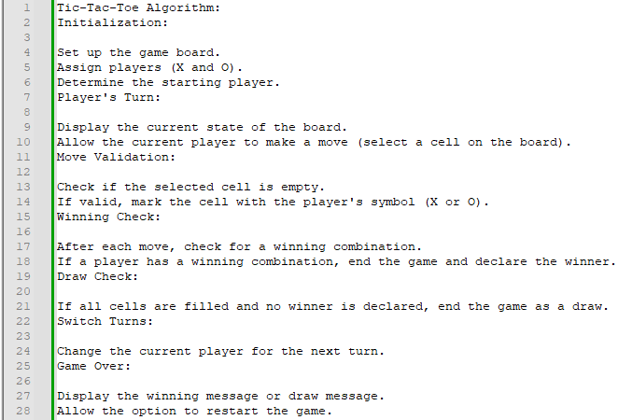
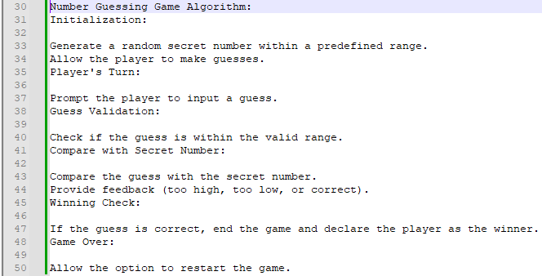
Design Algorithm

Slide 6
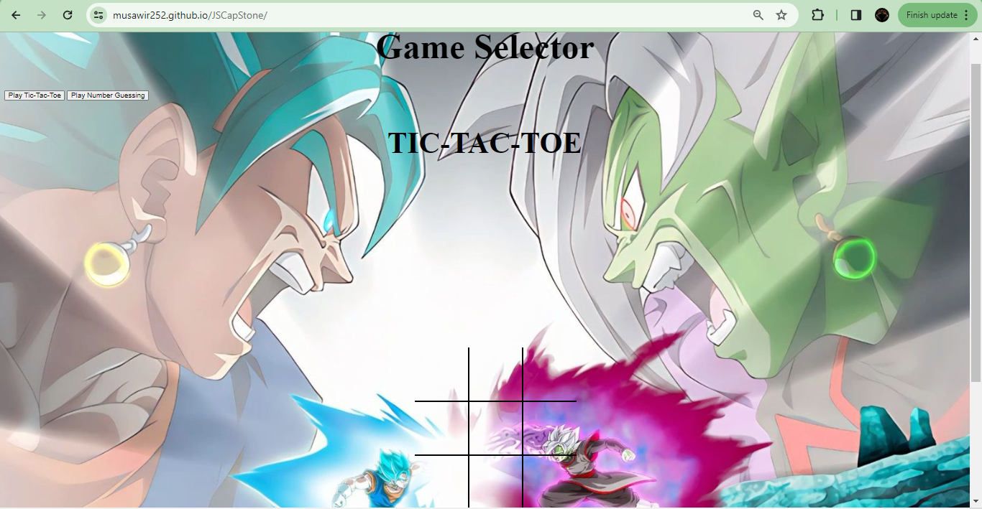
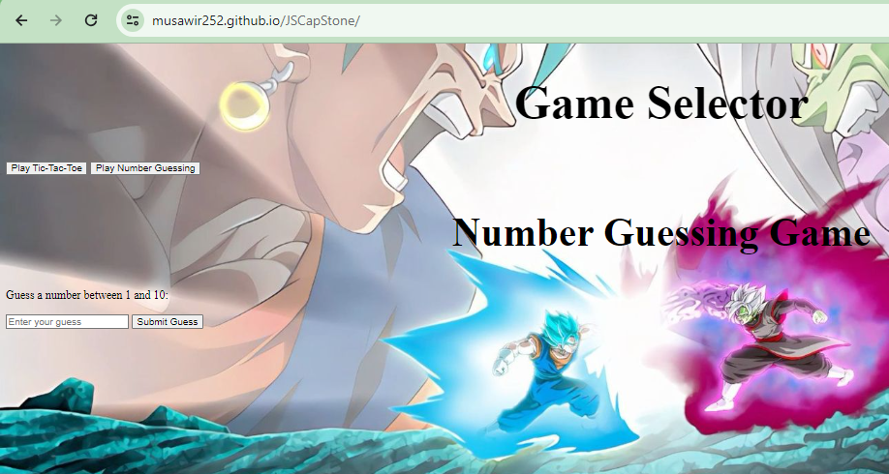
Project Output
Both games as outputted

Slide 7
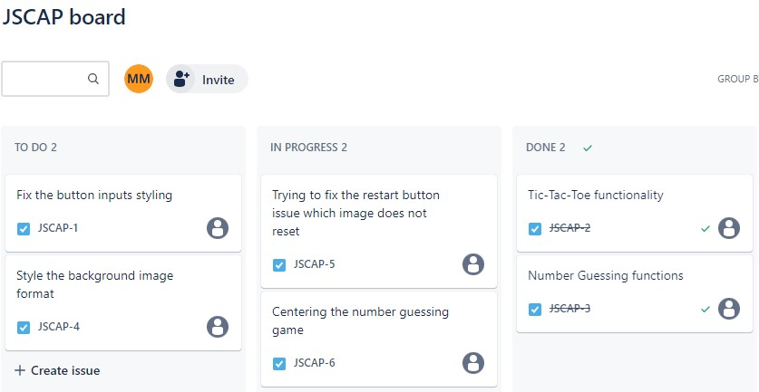
Jira implementation

Slide 8

Thank You!
Here is my LinkedIn: www.linkedin.com/in/mmehfuz7

